Slide 1
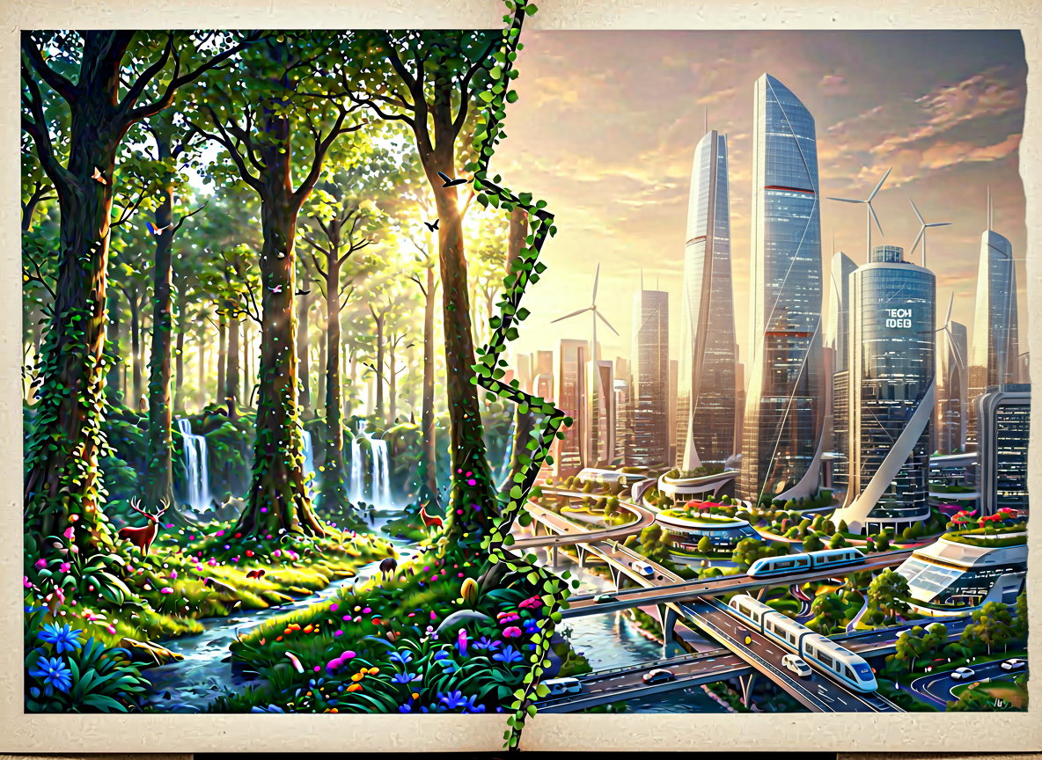
FOREST CONSERVATION IS MORE IMPORTANT THAN INDUSTRIAL GROWTH
BY:-
SKANDA RIDHAAN
AMIT ARVIN
ESHAAN UDBHAV

Slide 2
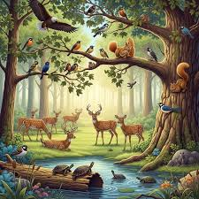
ARGUMENTS FOR THIS STATEMENT:-
Forests produce oxygen essential for all living beings and absorb excess carbon dioxide, thus helping mitigate climate change by reducing greenhouse gases in the atmosphere.
Forests provide shelter and habitat to diverse wildlife species and indigenous tribal communities, supporting biodiversity and cultural heritage.
Forests contribute to increased rainfall through their role in the water cycle, promoting regional climate stability and agricultural productivity.

Slide 3

Forest roots bind the soil together, preventing soil erosion and surface run-off, which helps maintain fertile land and reduces the risk of floods.
Forests promote tourism by offering natural spaces for relaxation and recreation, thereby supporting local economies and raising awareness about environmental conservation.

Slide 4

ARGUMENTS AGAINST THIS STATEMENT:-
Industrial growth significantly boosts the economy by generating wealth, increasing GDP, and creating business opportunities essential for national development.
Industries produce man-made goods and technologies that nature cannot provide, improving living standards and helping meet human needs.
Industrial development creates millions of employment opportunities across sectors, supporting livelihoods and reducing poverty.

Slide 5
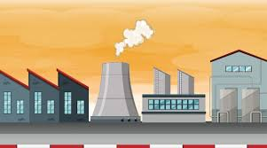
Improved infrastructure resulting from industrial growth facilitates better transportation, communication, and services, enhancing overall quality of life.
Industrialization drives technological advancements and innovation, fostering progress that can eventually support sustainable practices and environmental solutions.

Slide 6
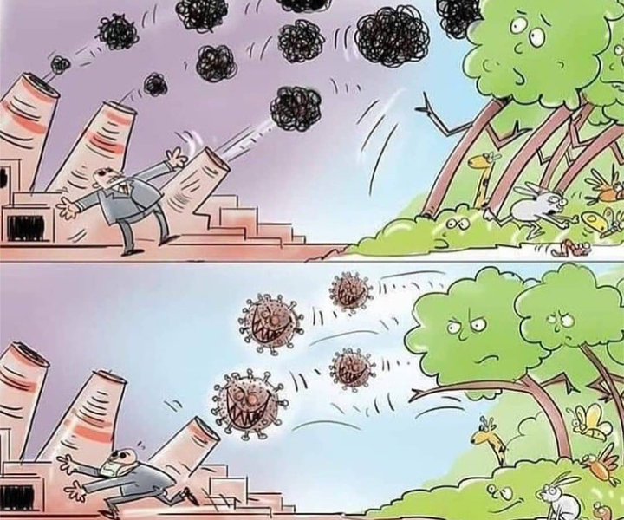
CONCLUSION:-
There is no clear answer to whether forest conservation is more important than industrial growth, as both are essential for sustainable development. Balancing environmental protection with economic progress requires careful planning and innovation. Future policies must integrate both priorities for long-term wellbeing.

